Slide 1
project: Research overview
January – July 2022

Slide 2
Your requirements
Tool background
Funding context
The focus of this proposed research is to ….
These resources are ultimately intended to support and enhance wider benefits around:

Slide 3

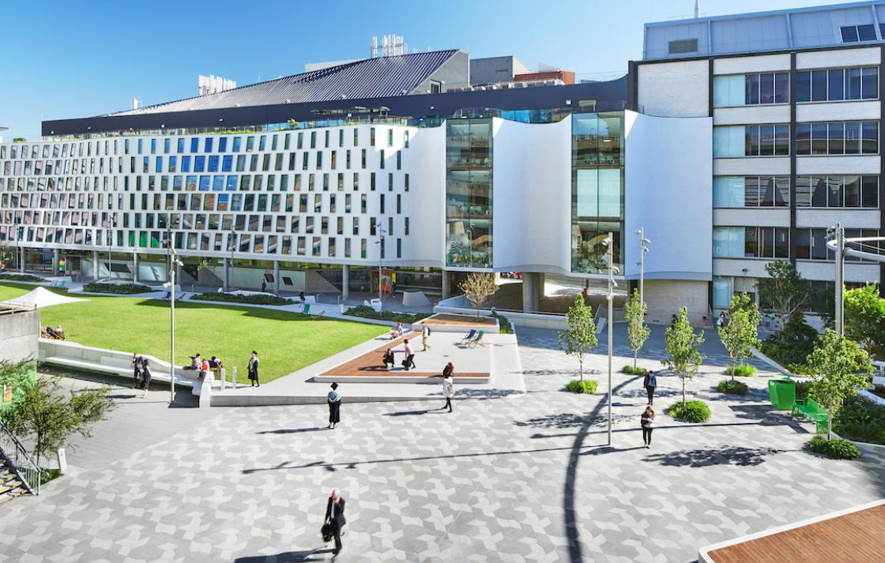

About us
Centre for Research on Education in a Digital Society
Explores the dynamic relationship between technology and learning – across formal, informal, and professional education contexts throughout the lifespan
Adopts sociocultural and human-centred approaches to understanding technology in practice to investigate learning technologies, the role of technology and data in learning and the changing learning needs of a digital society
Another unit
…
…

Slide 4

Research team
Dr Simon Knight
Research Lead
Simon is Director of the Centre for Research on Education in a Digital Society, and leads the Transformative Learning research theme in the UTS Transdisciplinary School.
He is a recognised researcher in learning and technology and a UTS award winning teacher. He holds a PhD in learning analytics, and education Masters from both Cambridge and UCL Institute of Education, where he also did his high-school teacher training

Slide 5
Project description Overview
As a university committed to practical innovation and the development of impact-driven research that benefits the broader community, UTS is a key partner to industry in helping shape the world we live in. This is built on our culture of collaboration, creativity, use of agile and transdisciplinary approaches, and our industry and community connections to create real-world solutions to complex problems.
UTS has assembled a team of skilled researchers for this project, with expertise in participatory approaches, including for ….
We will take a participatory approach to the design and delivery of the research project, across four stages of work outlined below. This will involve desk research around scholarly and practitioner resources, identification of key needs and user expectations, the development of both practical wellbeing resources and initial prototyping for implementation of these resources into the tool.
Stage 1: Initiation
Stage 2: Desk research
Stage 3: User needs
Stage 4: Development
Scoping & planning
Secure funding
Contracting
Research focus areas
Design engagement methods & instruments
4a. Content development
Inception & ‘Discovery’
In-depth desktop research
engagement on experience and needs needs
4b. Prototyping implementation / integration of resources
Research ethics

Slide 6
Project description Approach and key deliverables
Stage | Proposed approach | Key deliverables
1. Project initiation
2. Desk research
3. User needs
4. Development

Slide 7
Project schedule Timeline and key milestones
The project initiated on the basis of a …start and … end, with tolerance for.
Key milestones were:

Slide 8
Project: Project commencement
January – July 2022

Slide 9
Research approach & scope
"What we wish to research and develop is …."
Key inputs:
Proposal text + initial literature survey
Existing tool & resources
Co-design and iteration of our approach together
Considerations:
Current UX and articulating the evidence base
Evidence for most impactful new resources
Evidence & user input re: how to integrate those into evolving UX
Mapping approach

Slide 10
Developing a logic model through a feature:outcome matrix:
Why? Allows us to map Qs & evidence to claims you may make around impact & narrow scope
How? Review by team, and mapping to literature
Desk research to situate … in the evidence:
Why? Provide existing grounding of tool; Suggest new avenues & critical areas of focus
How? Use the model to guide literature survey & create scenarios identifying potential critical incidents & literature around these
User research to identify resource needs and integration:
Why? Understand what users currently draw on, triangulate with literature & test piloting (split phase)
How? Use scenarios with screenshots of tool journeys to identify existing resources to integrate, & identify where these are needed
Resource development grounded in evidence for your outcomes:
Why? Stages 1:3 identify needs & ground how to address these, phase 4 builds (in a way you can adapt in future)
How? Create a resource template for items & their integration, create/curate resources addressing key needs and segments
Stage 1: Initiation
Stage 2: Desk research
Stage 3: User needs
Stage 4: Development
Scoping & planning
Secure funding
Contracting
Research focus areas
Design engagement methods & instruments
4a. Content development of 5-6 key practical ‘support resources’
Inception & ‘Discovery’
In-depth desktop research
engagement on experiences and needs
4b. Prototyping implementation / integration of resources into the tool
Research ethics

